Slide 2
Chautauqua Interactive
Advisors:
The Team:
Drew Davidson
Brenda Harger
Goutham Dindukurthi
Kyle Dolan
Ben Miller
Francisco Souki
Aaron Vanderbeek
Client Representatives:
Margaret Johnson
Bonnie Nelson Schwartz

Slide 3
The Client
LakeArts
Foundation
Putting on the International Festival of Arts and Innovation
Gated community known for 9 week-long Summer Season featuring Opera, Theater, Dance, Lectures, etc.

Slide 4
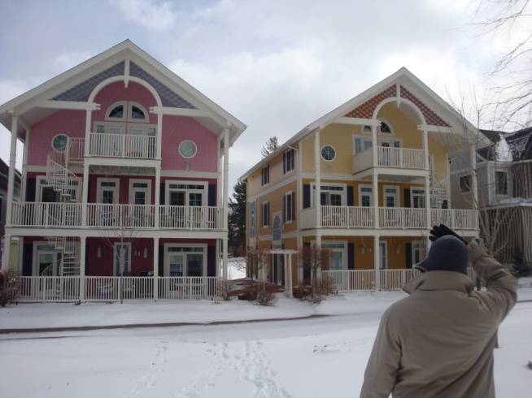
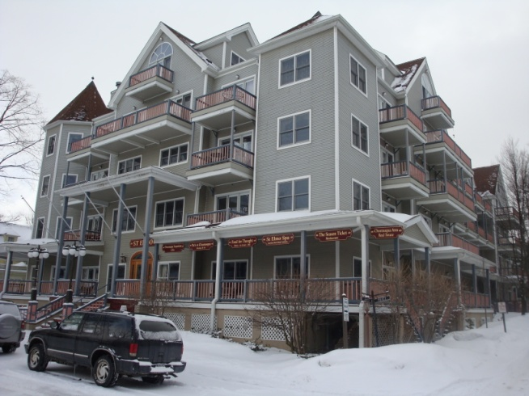
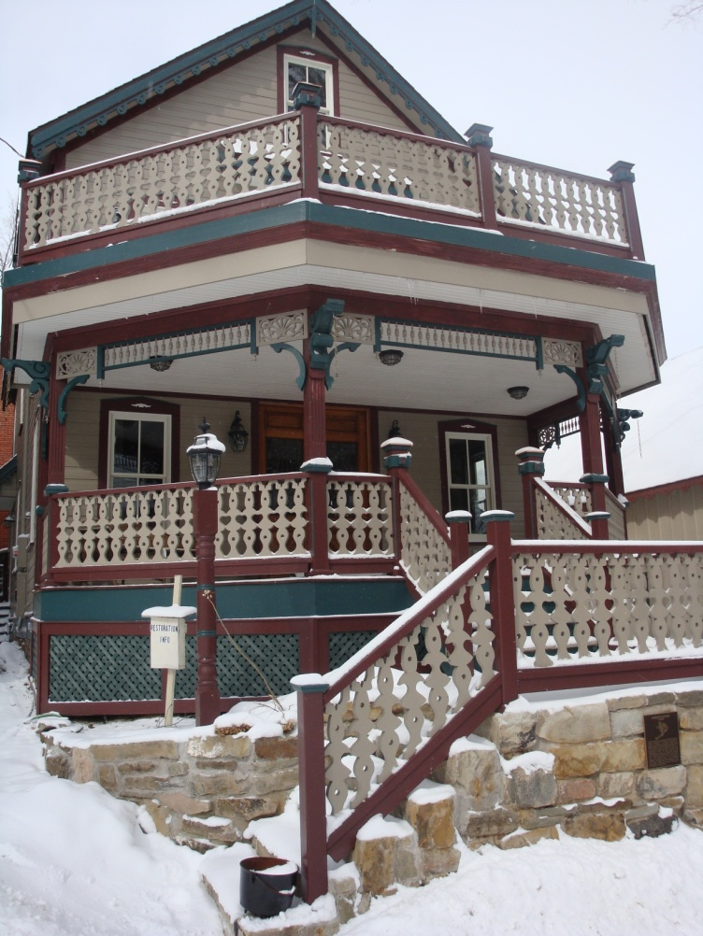
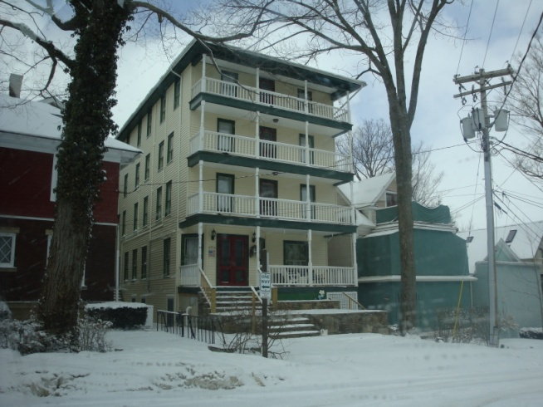
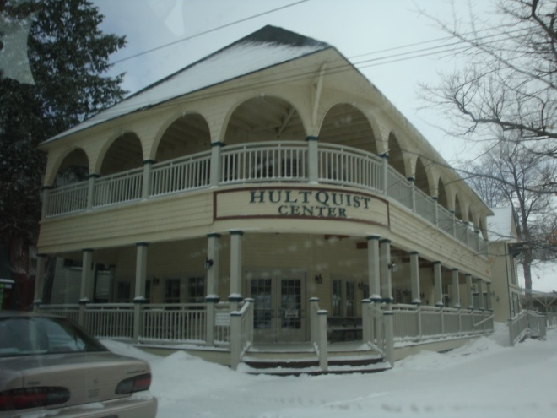
The Client

Slide 5
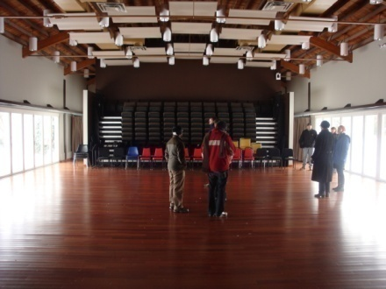
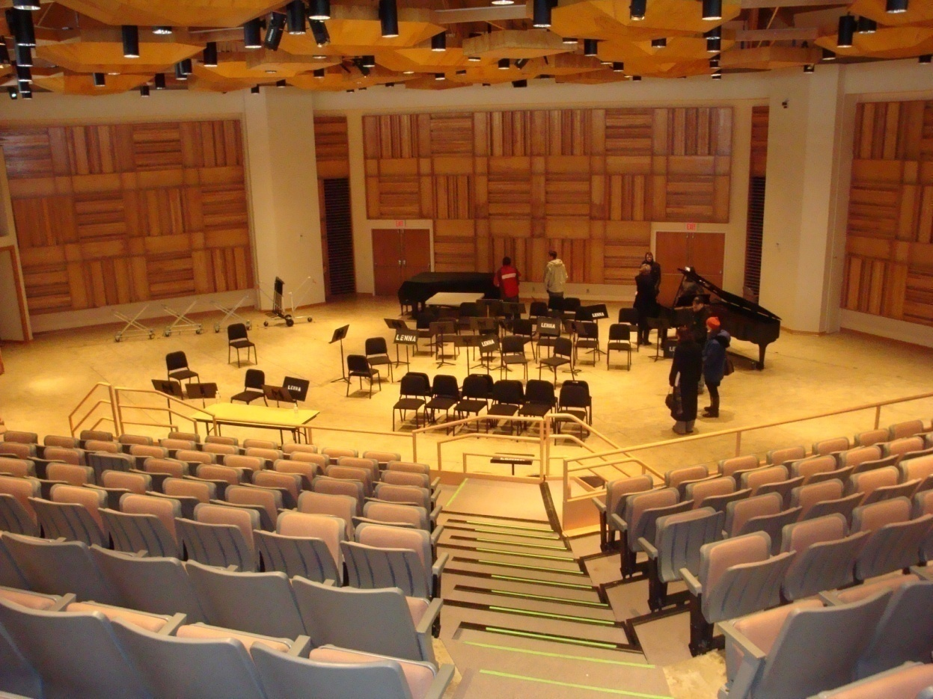
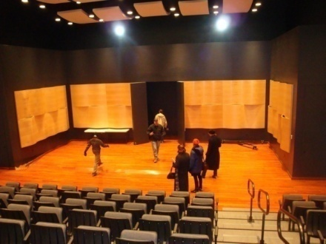
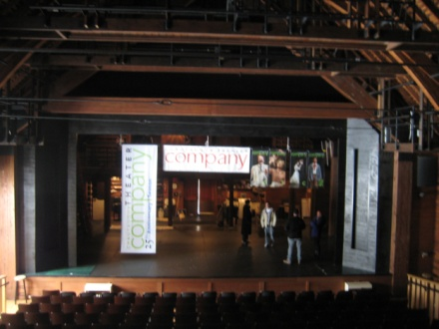
The Client

Slide 6
Our Audience
Well-heeled intellectuals
Not necessarily familiar with high-tech
The most tech-based solutions could still ignite very interesting discussions

Slide 7
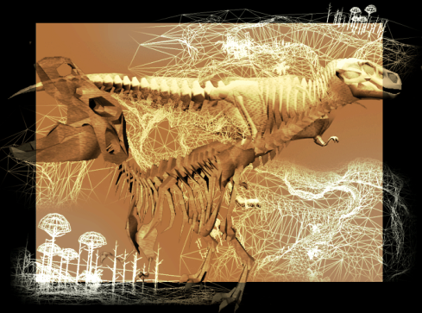
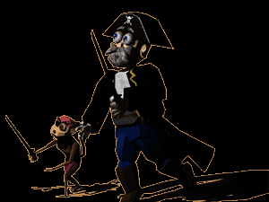
Previous ETC Projects
EROShambo

Slide 8
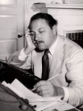
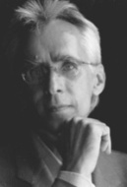
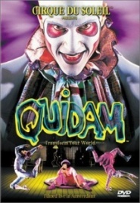
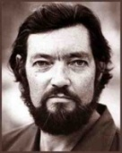
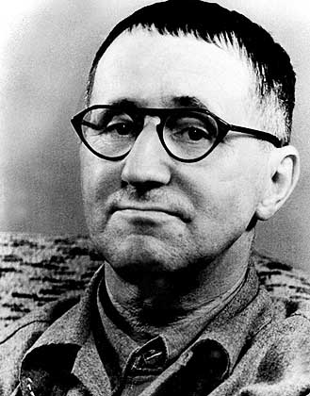
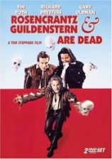
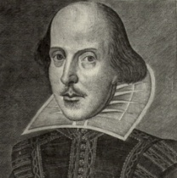
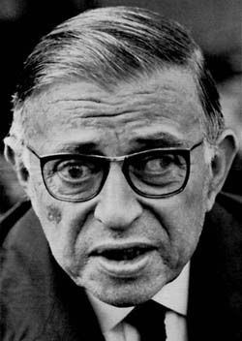
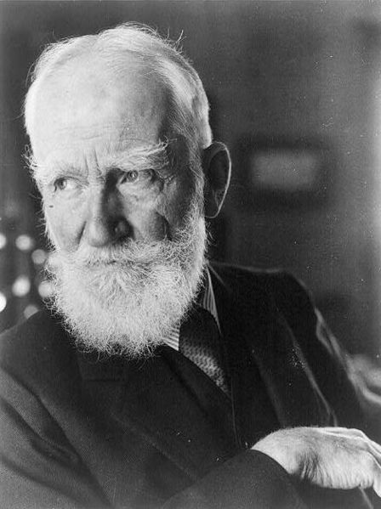
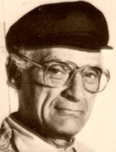
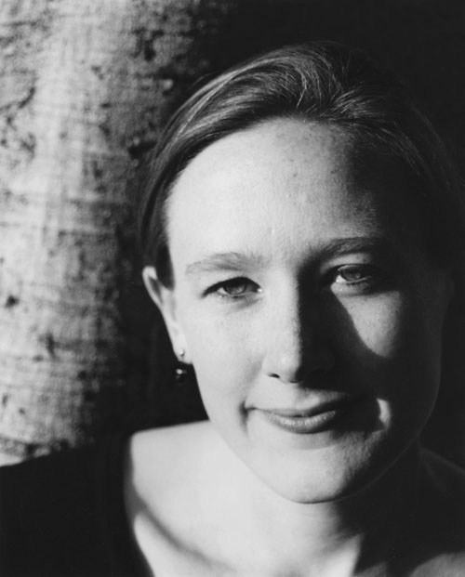
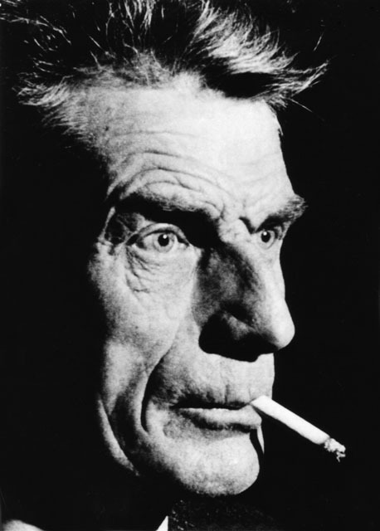
Research
Short Stories
Full Length Plays
1-Act Plays
Film
Performance

Slide 9
Research
Short Stories
Full Length Plays
1-Act Plays
Film
Performance
PERSPECTIVE

Slide 10
Our Goal
To combine technology and theatrical performance art with the purpose of creating a meaningful interactive experience for the audience
To engender the feeling of agency in the audience, which we believe will significantly enhance the experience created by a theatrical performance on many levels

Slide 11
Deliverable
Evolution of a Deliverable
A two hour-long performance

Slide 12
Deliverable
Evolution of a Deliverable
A two hour-long performance
Three small proof of concept prototypes

Slide 13
Deliverable
Evolution of a Deliverable
A two hour-long performance
Three small proof of concept prototypes
Two 20 minutes-long proof of concept prototypes

Slide 14
Deliverable
Evolution of a Deliverable
A two hour-long performance
Three small proof of concept prototypes
Two 20 minutes-long proof of concept prototypes
One full performance and the Design Document for a second one

Slide 15
Deliverable
September:
The Symposium at Chautauqua:
Performances
Discussion / Panel
At least two team members should be available to go to Chautauqua in September

Slide 16
Design Concepts
Quarter Presentations

Slide 17
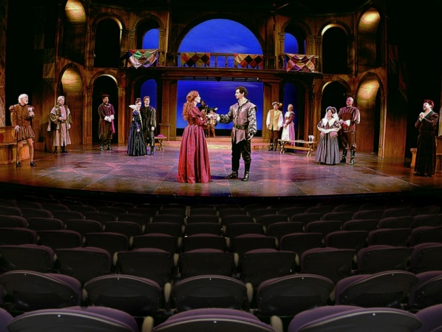
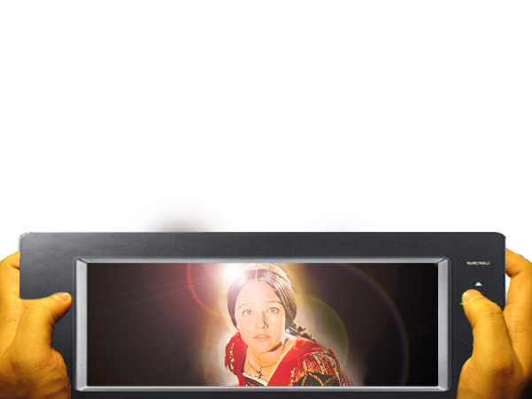
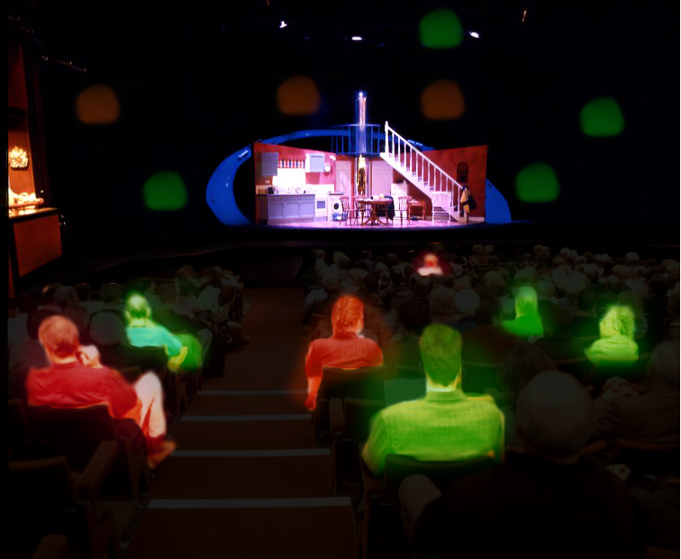
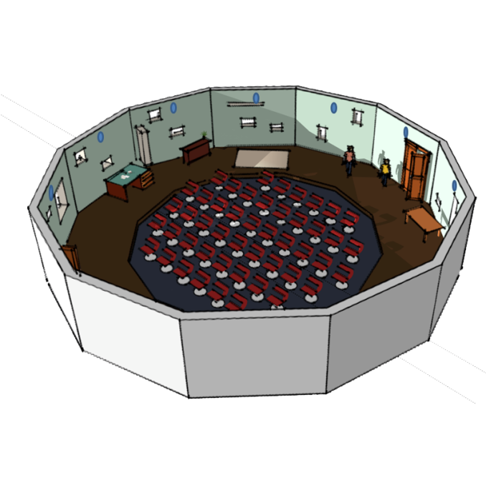
Design Concepts
Quarter Presentations

Slide 18
Design Concepts
Half Presentations

Slide 19
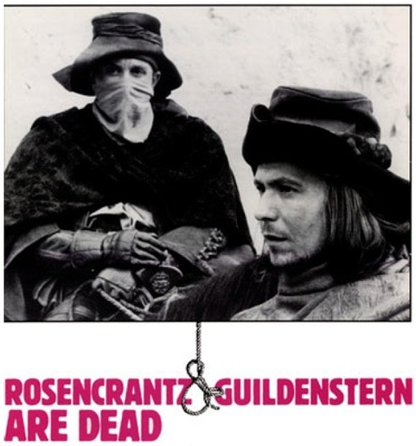
Design Concepts
Half Presentations

Slide 20
Hamlet
Final Designs
Design Document fully completed
Purchased most of the tech
Tech solutions at 70%
However, we chose not to put on a performance

Slide 21
Rashomon
Final Designs

Slide 22
Rashomon
High Concept - Goal
Exploiting the emphasis on perspectives in the story “Rashomon” to give an audience meaningful choices to make in a non-traditional theater setting

Slide 23
Rashomon
The Story
Bandit
Everyone
Agrees
Wife
Husband

Slide 24
Rashomon
Projection Screens
Layout
Projections represent characters in court, while actors represent the reenactment of testimonies
Stage area
Swivel chairs

Slide 25
Rashomon
Beginning Layout
All introductory stories play at the same time, with the audience’s collective attention determining volume levels

Slide 26
Rashomon
Beginning Layout
Audience’s attention will determine which character testifies first

Slide 27
Rashomon
Character’s Testimony
The other characters’ projections react to the story as it is being told

Slide 28
Rashomon
In the end
The performance order potentially varies from one show to the next
Audience members will be asked to provide judgment
We will analyze the data and find possible relationships to the play’s order

Slide 29
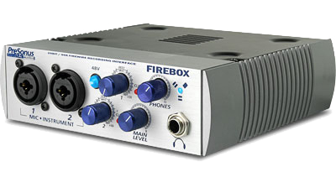
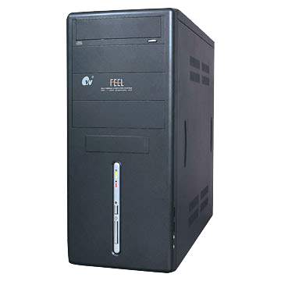
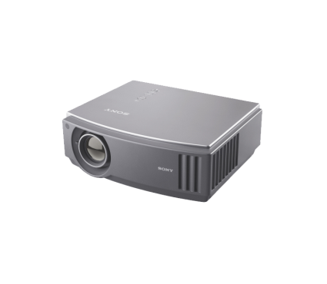
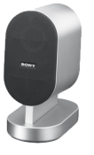
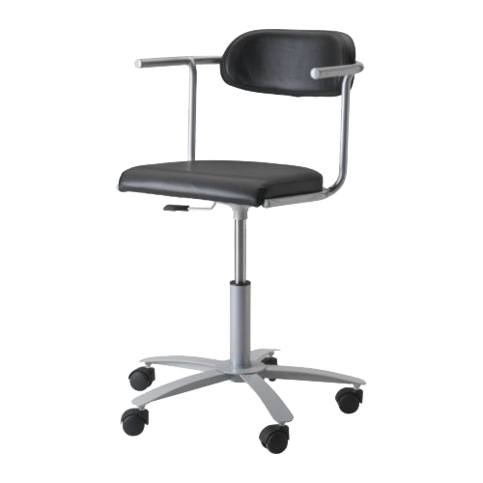
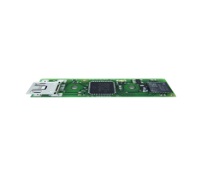
Technology

Slide 30
Technology
Midi data sent to Max/MSP/Jitter
Midi data sent to external controller
Outputs sound with different volumes to three speakers
Jitter outputs three videos to separate projectors
C++
PC translates sensor data to MIDI
Sensor communicates with PC via USB

Slide 31
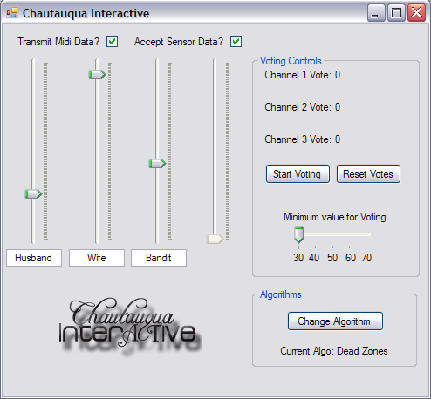
Technology

Slide 32
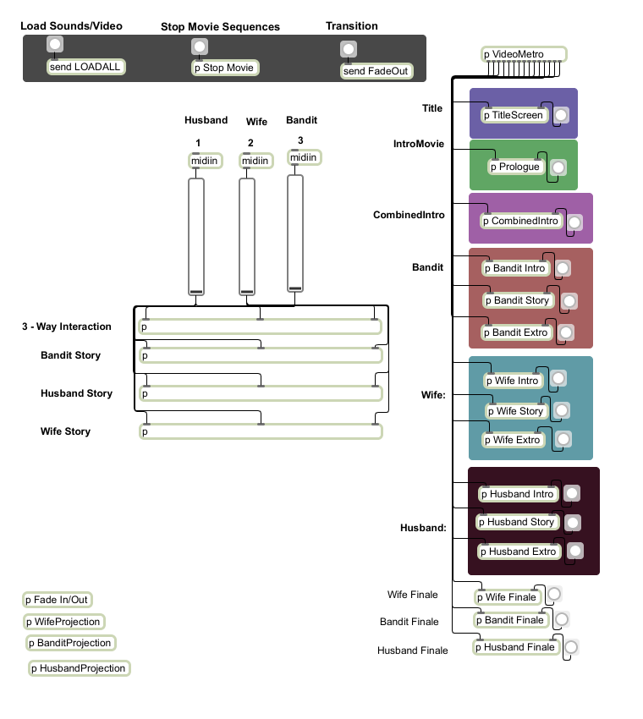
Technology

Slide 33
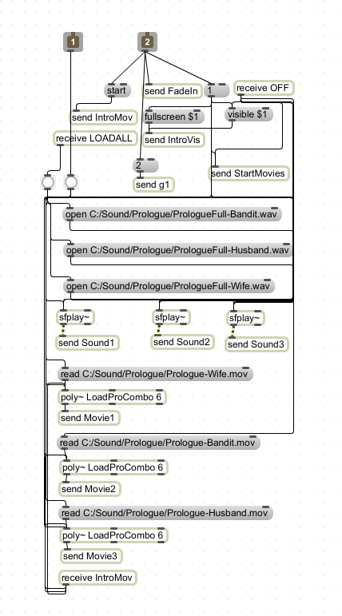
Technology

Slide 34
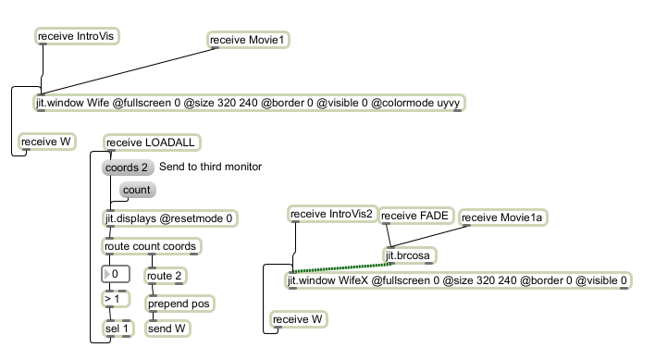
Technology

Slide 35
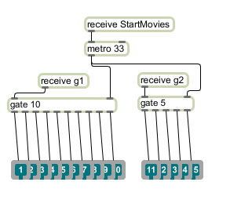
Technology

Slide 36
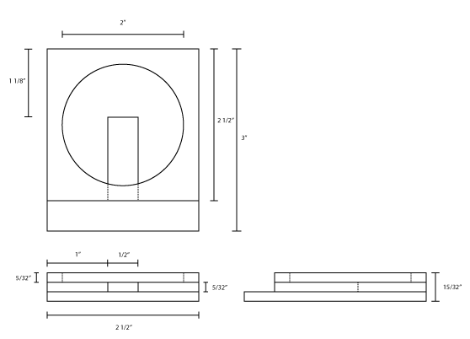
Technology
Sensor
Casing

Slide 37
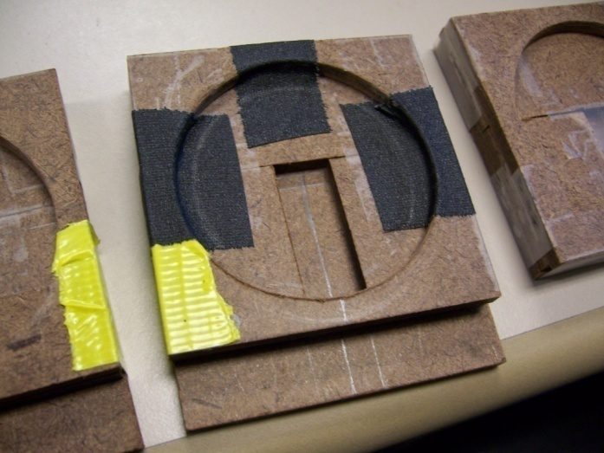
Technology
Sensor
Casing

Slide 38
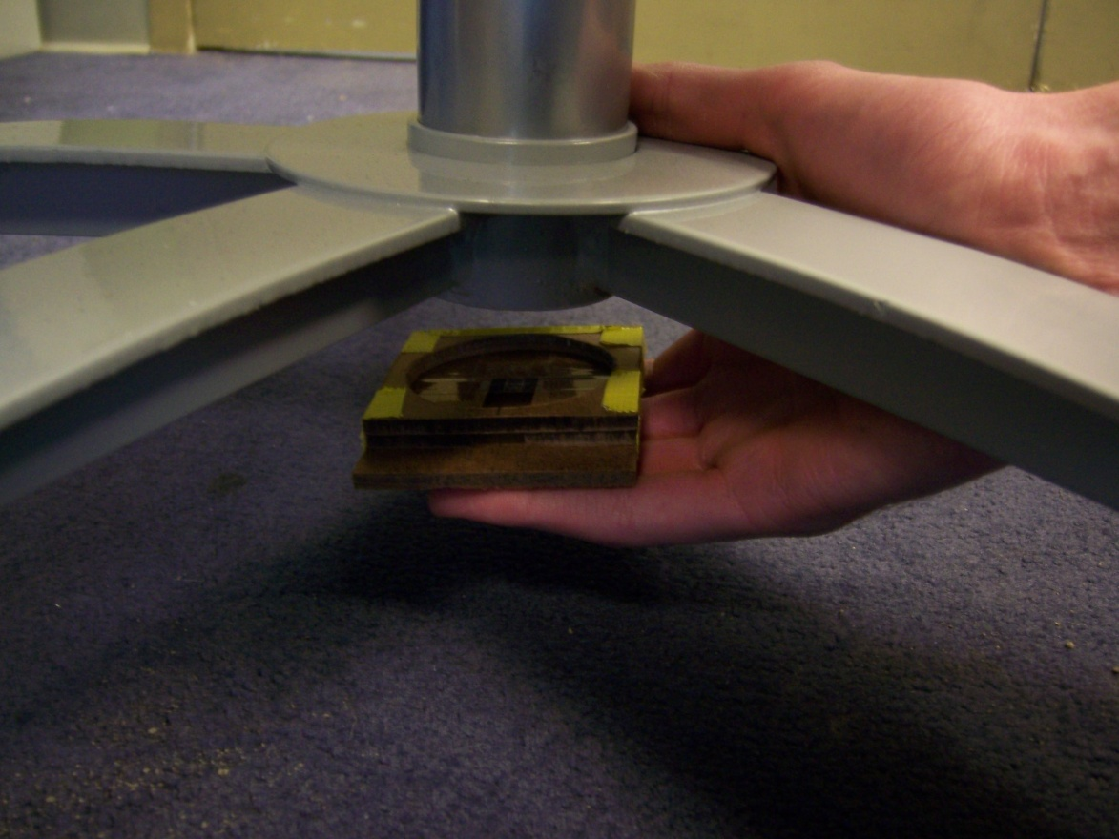
Technology

Slide 39
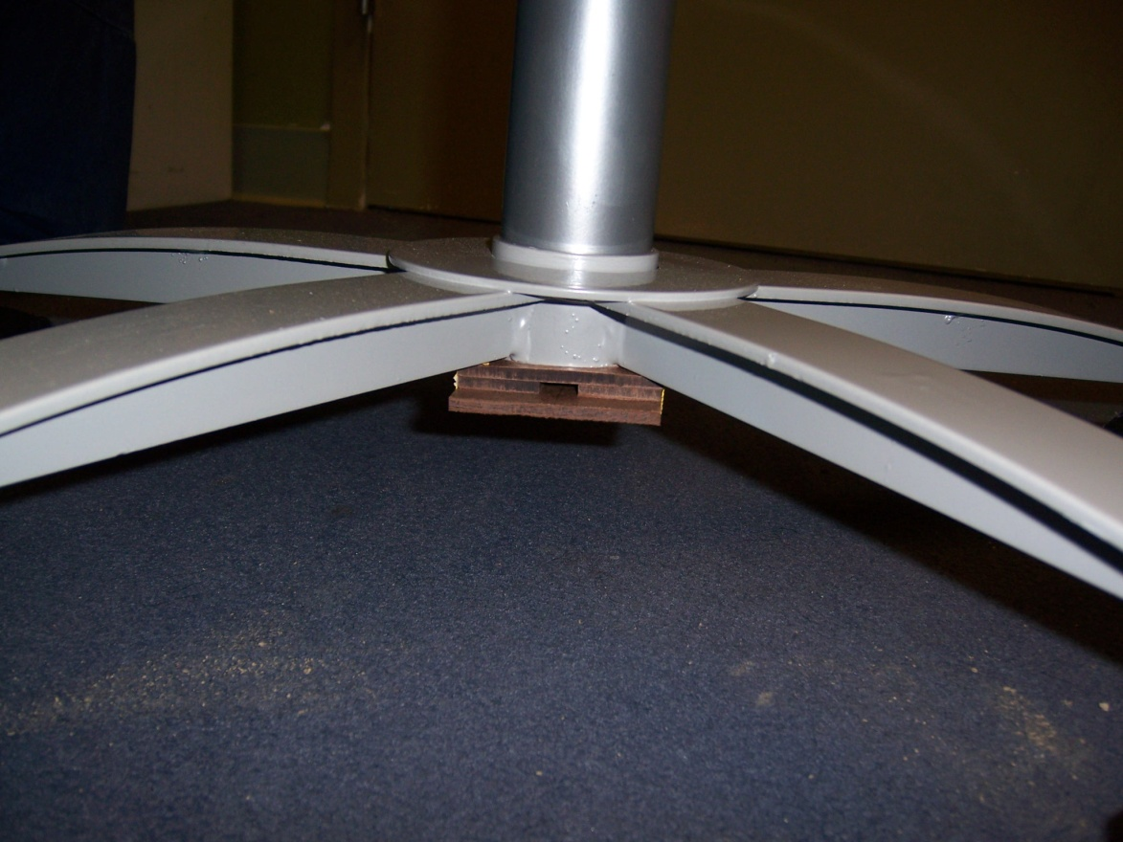
Technology

Slide 40
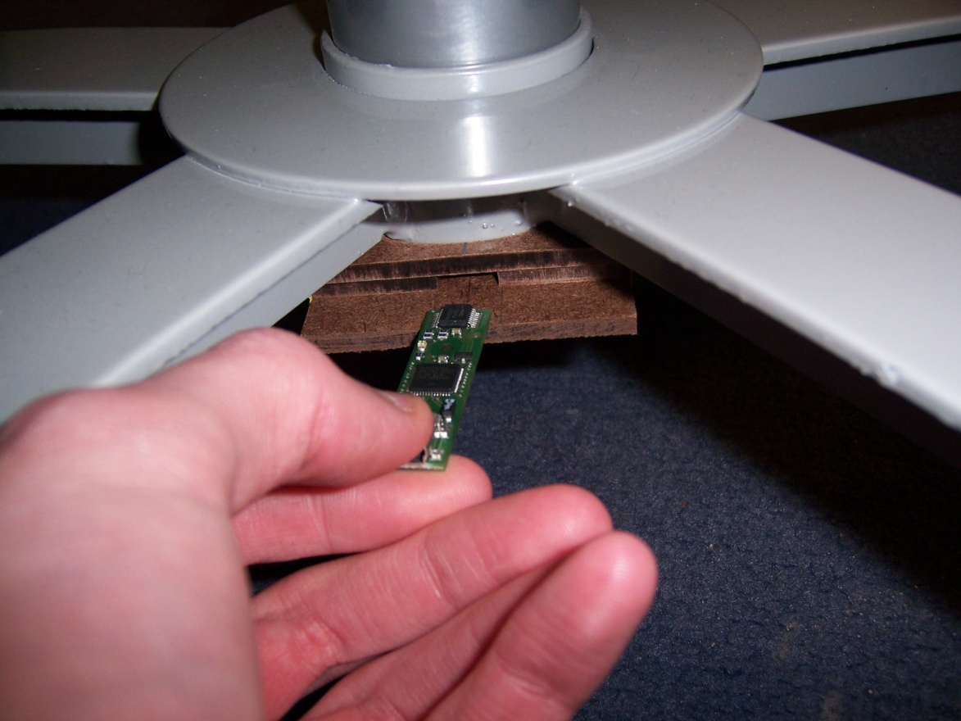
Technology

Slide 41
Playtesting
Playtesting
Wizard of Oz Playtesting

Slide 42
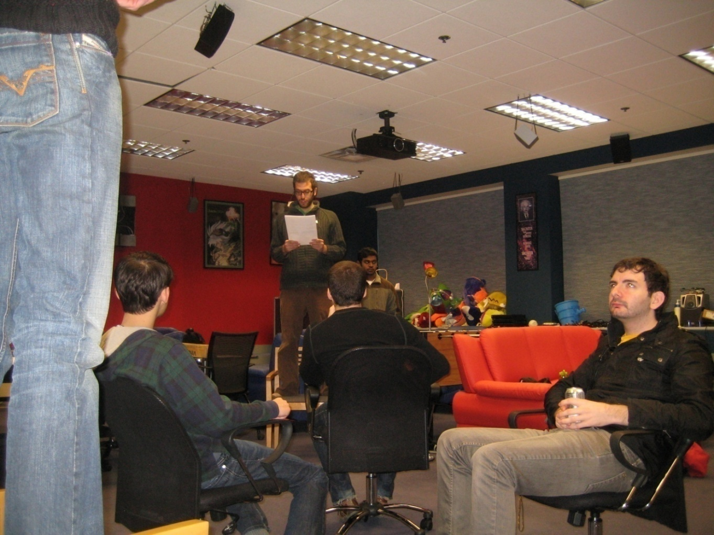
Playtesting

Slide 43
Playtesting
Playtesting
Wizard of Oz Playtesting
Tech Playtesting

Slide 44
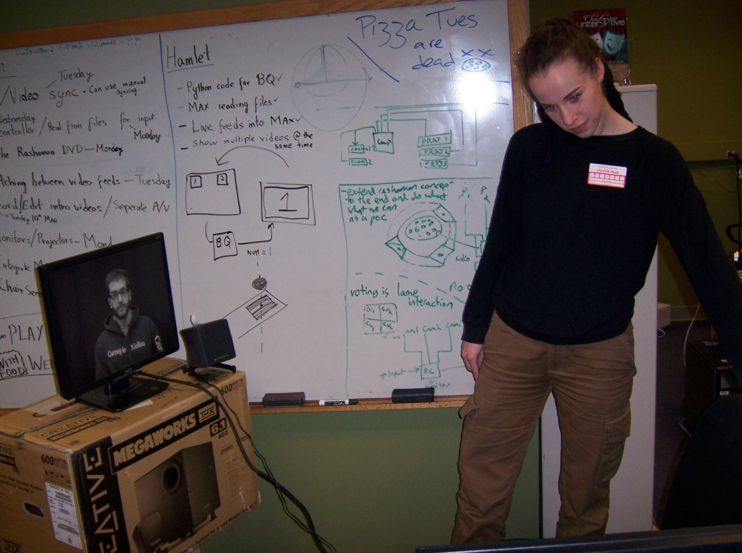
Playtesting
Playtesting

Slide 45
Playtesting
Playtesting
Wizard of Oz Playtesting
Tech Playtesting
Guest + Tech Playtesting

Slide 46
Playtesting
Playtesting
Wizard of Oz Playtesting
Tech Playtesting
Guest + Tech Playtesting
Soft Opening

Slide 47
Soft Opening
Open House
Ran the Intro section for guests
Full Performance
At the MPR
25 minutes long
Equivalent to Dress Rehearsal
Hired professional actors

Slide 48
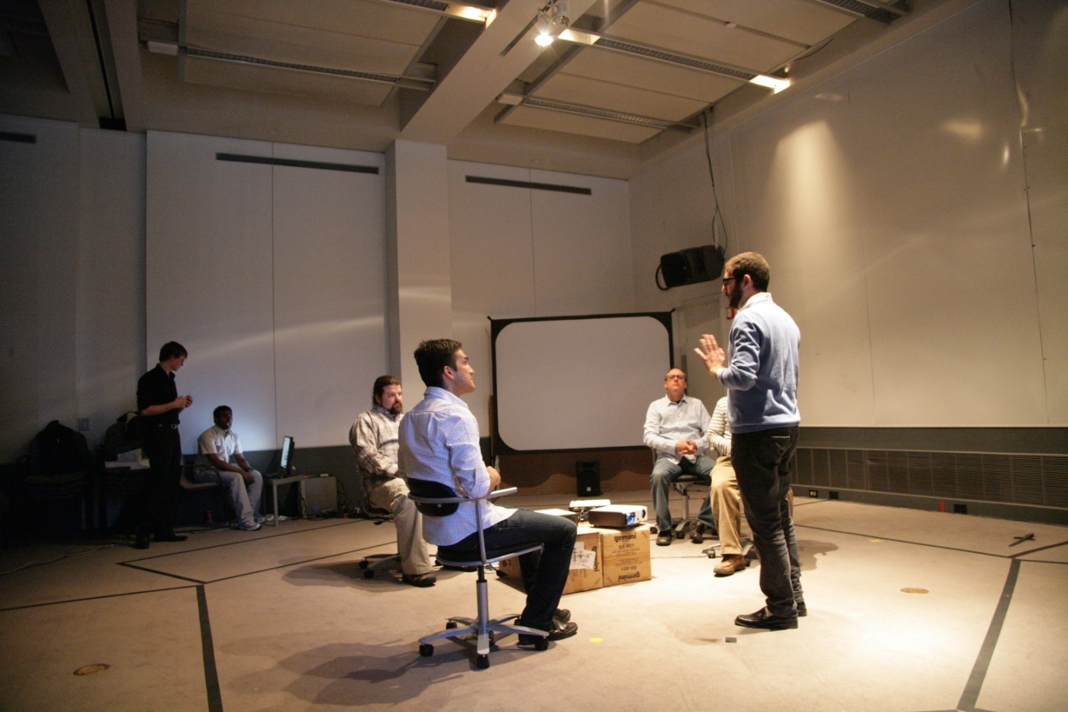
Soft Opening

Slide 49
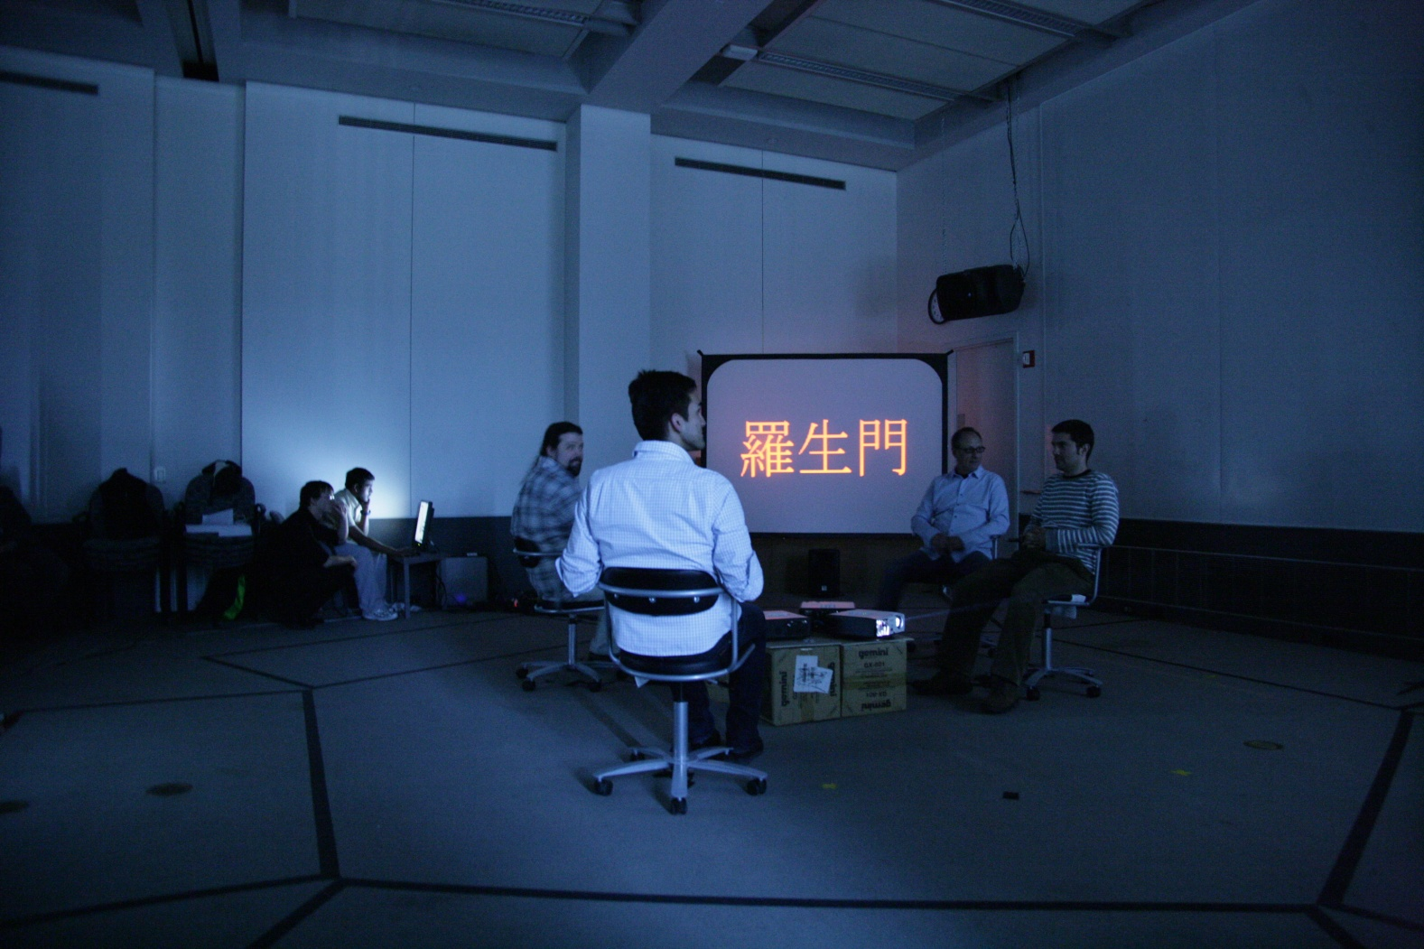
Soft Opening

Slide 50
Soft Opening
Feedback from Soft Opening
Actors add a lot to the performance
Work to fix tech issues with sensors and video
How much should you tell the guests beforehand?
Emerging social interaction is interesting, but is it desirable by the audience?

Slide 51
Preparing for Final
In Response to Feedback
Optimize hardware and software
Prepare and construct final product in theatre space
Market our performance to maximize attendance

Slide 52
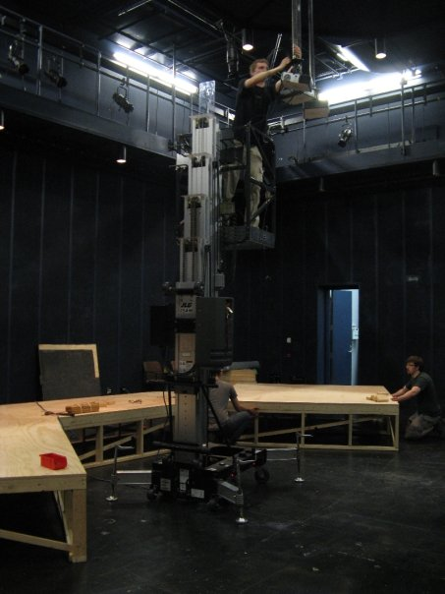
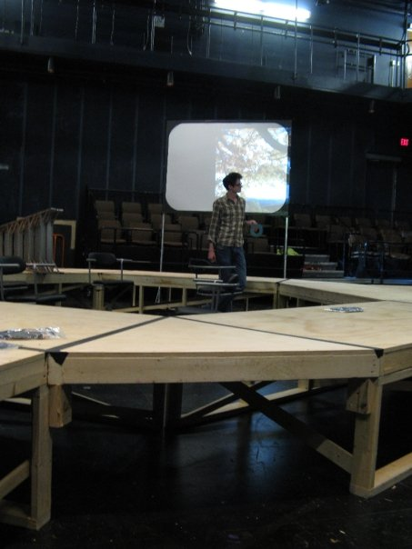
Final Performance
Unleash the power of Rauh!

Slide 53
Final Performance

Slide 54
Final Performance

Slide 55
Final Performance

Slide 56
Final Performance

Slide 57
Final Performance

Slide 58
Final Performance

Slide 59
Final Performance

Slide 60
Final Performance

Slide 61
Final Performance
Movie Time!

Slide 62
Lessons Learned
What went right
Great team dynamics
Forged a connection with the Drama School
Scrum process was very effective
A lot of intelligent discussion ensued
Managed to get the performance as close to a professional performance as possible

Slide 63
Lessons Learned
What went wrong
We had to constantly re-scope, but we finally got it right!
Tech will always fail you at some point
Did not put on Hamlet
Tutorial did not work as planned
Could have used more testing, especially
early on

Slide 64
Thanks!
Drew Davidson
Brenda Harger
Allen Hahn
Margaret and Bonnie
Janice Metz
Caitlin Zunic
Karen, Greg, Ted and Tom
Anthony Daniels
John Buchanan
Our Playtersters
Asha, Beef and Mallila
Don Marinelli
Steve Audia
Jim Valenti
Alex, Brandon and Ryan
Marianne Weems
Oscar García
Ruth Comley
Debi Pils
John Conomikes
The Angry Mob
Harmon Pollock

Slide 65
A Bridge for the Future
Notes:
We are very proud of having worked together both with the ETC faculty and with Allen Hahn to build the foundations of a bridge between the ETC and the School of Drama. We hope that just like this real bridge, the Randy Pausch Memorial Bridge, connects a Technology building to a Drama building, so the metaphorical bridge we have started to build will continue to be improved upon by future ETC projects so that our relationship with the drama school solidifies.

Slide 66
A Bridge for the Future

Slide 67
Questions?
Visit us at Room #2406
Or
http://www.etc.cmu.edu/projects/chautauqua-festival/
E-mail us at
ChautauquaInteractive2009@gmail.com

